Slide 1
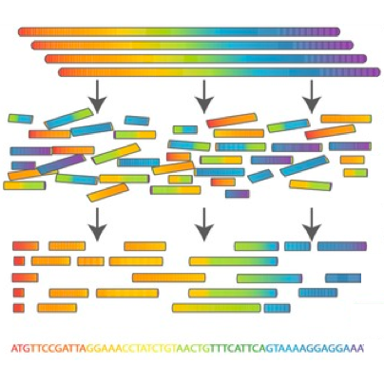

Scientific Computing for Biologists

Slide 2
Scientific Computing for Biologists
About the course and the Instructor
Overview of the syllabus
Final Project
About you all!?
Who are you?
Where are you from?
Faculty advisor and focus area?
What do you hope to get from this class?

Slide 3
Scientific Computing for Biologists
Then:

Slide 4

Scientific Computing for Biologists

Slide 5
Scientific Computing for Biologists
Slide detailing history and significance of scientific computing:

Slide 6
Scientific Computing for Biologists
Then:

Slide 7
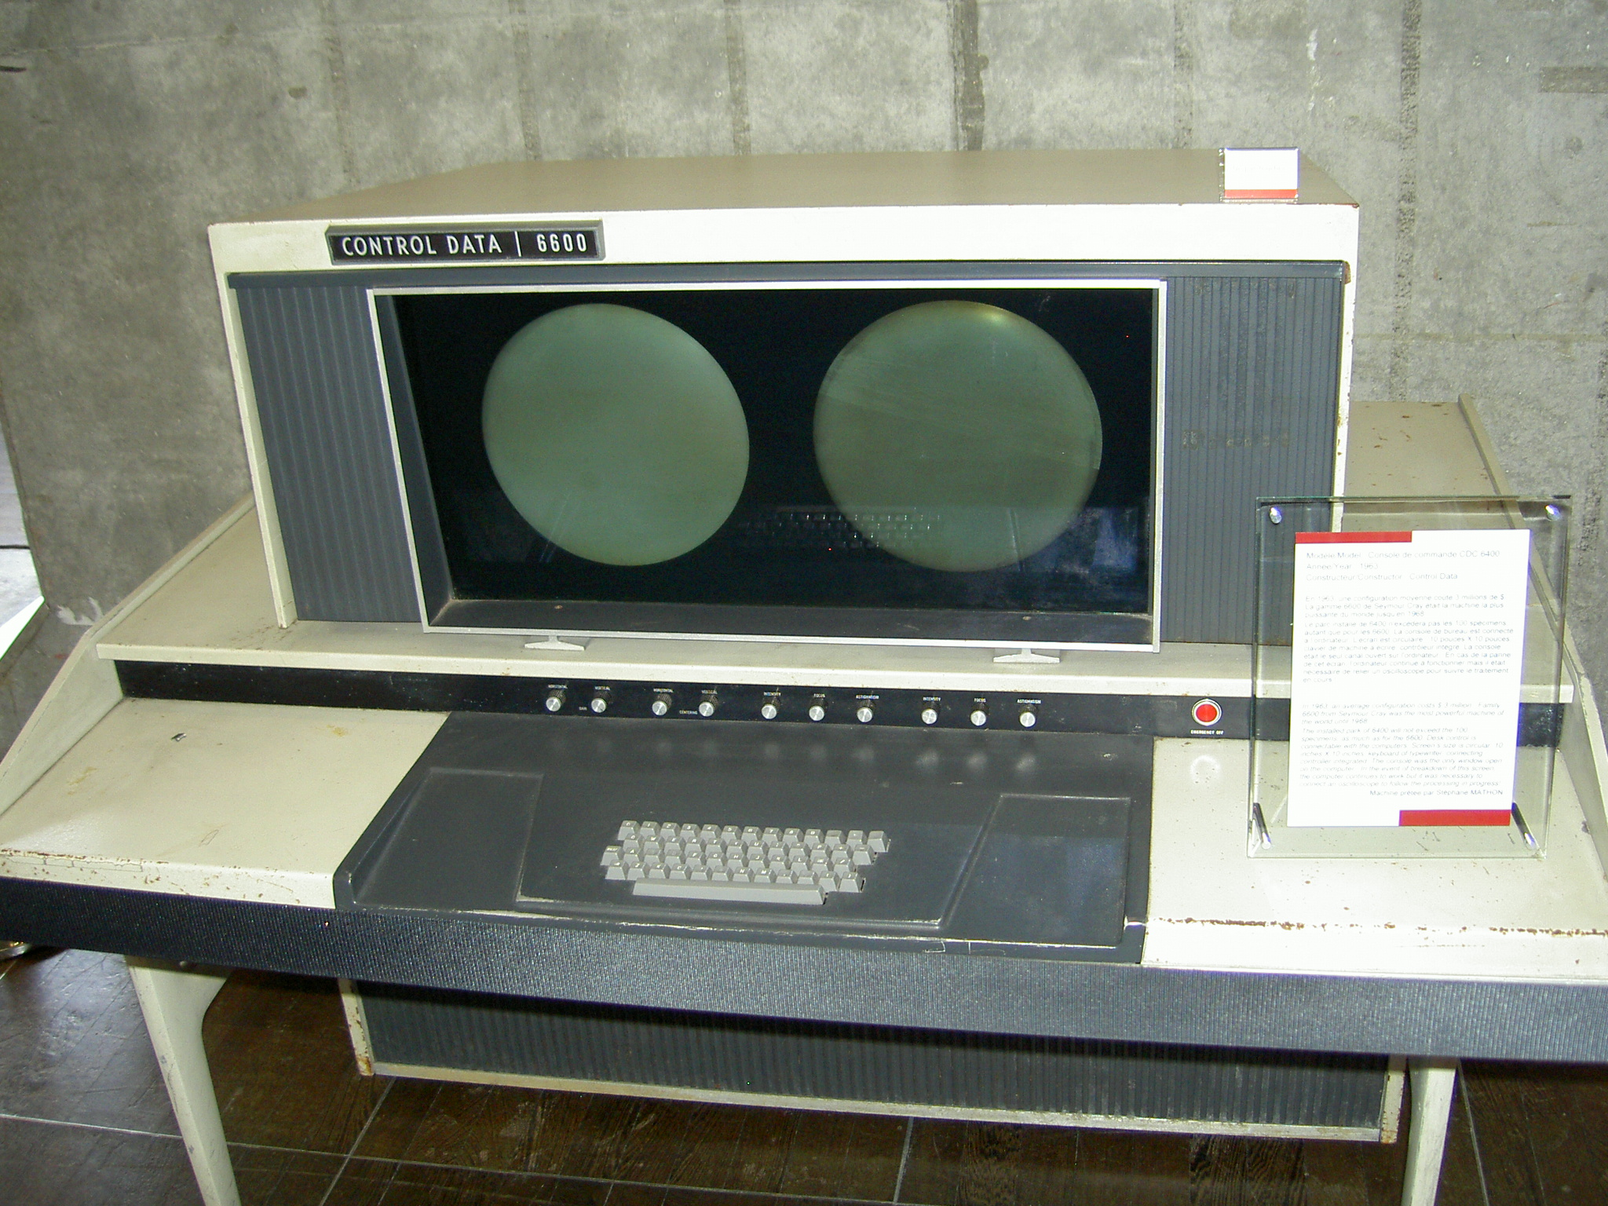
Scientific Computing for Biologists

Slide 8
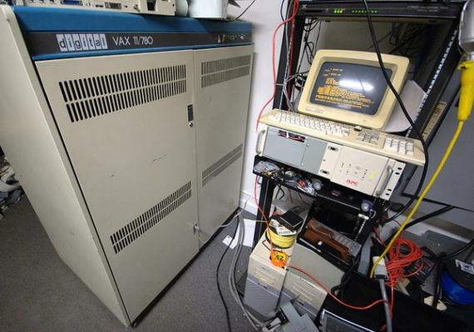
Scientific Computing for Biologists

Slide 9

Scientific Computing for Biologists

Slide 10
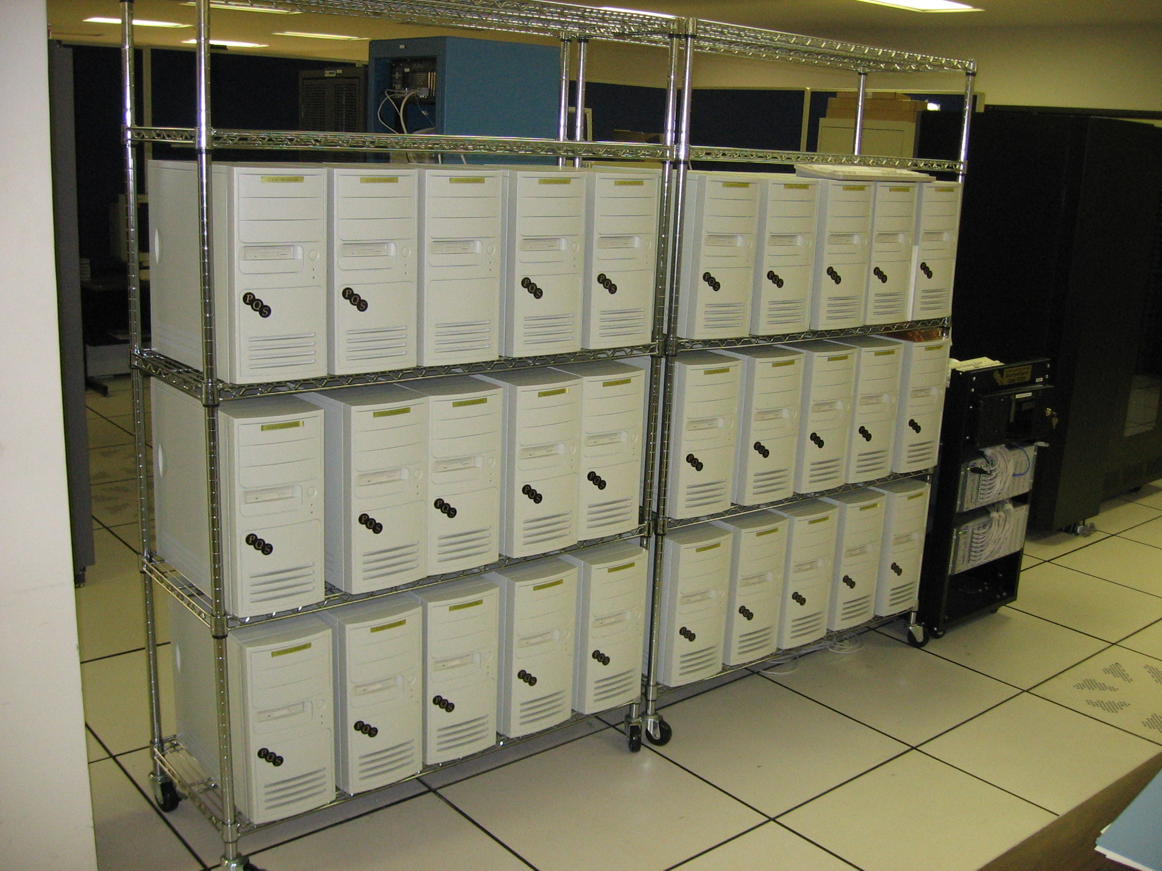
Scientific Computing for Biologists

Slide 11
Scientific Computing for Biologists
Now:

Slide 12
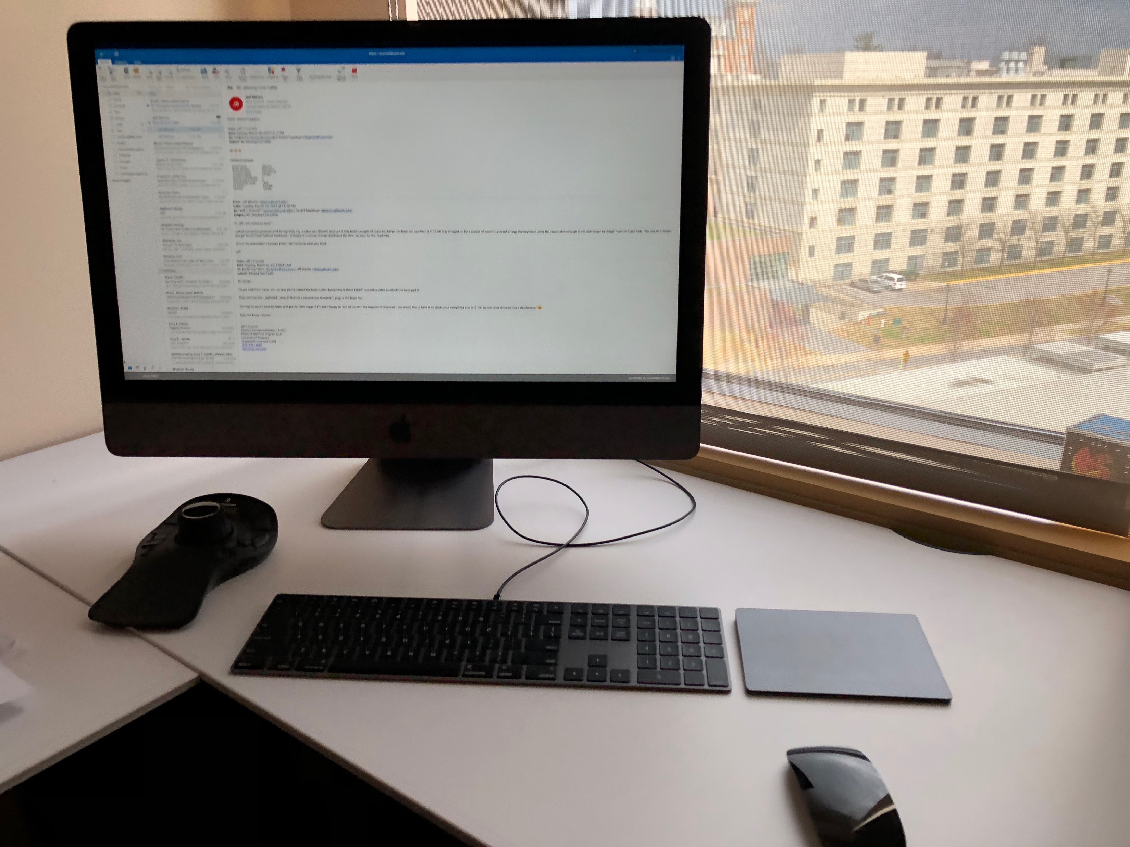
Scientific Computing for Biologists

Slide 13
Scientific Computing Resources
for Biologists

Slide 14
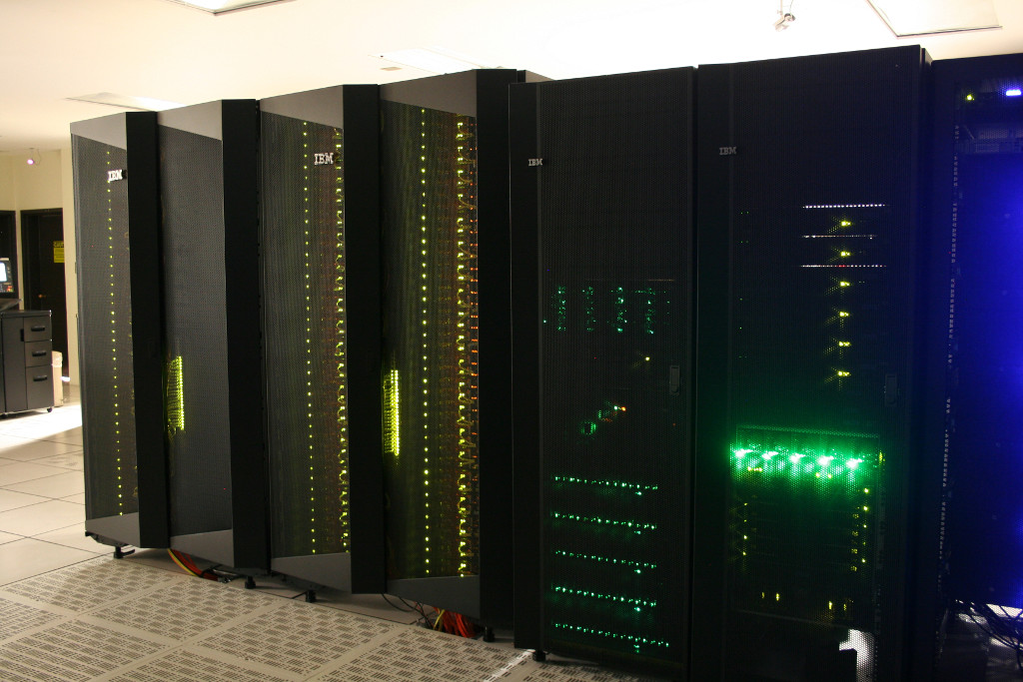

Scientific Computing Resources
for Biologists

Slide 15
Scientific Computing Resources
for Biologists

Slide 16


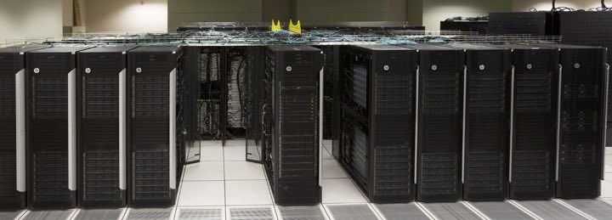
Scientific Computing Resources
for Biologists

Slide 17

Scientific Computing for Biologists

Slide 18

Scientific Computing for Biologists

Slide 19

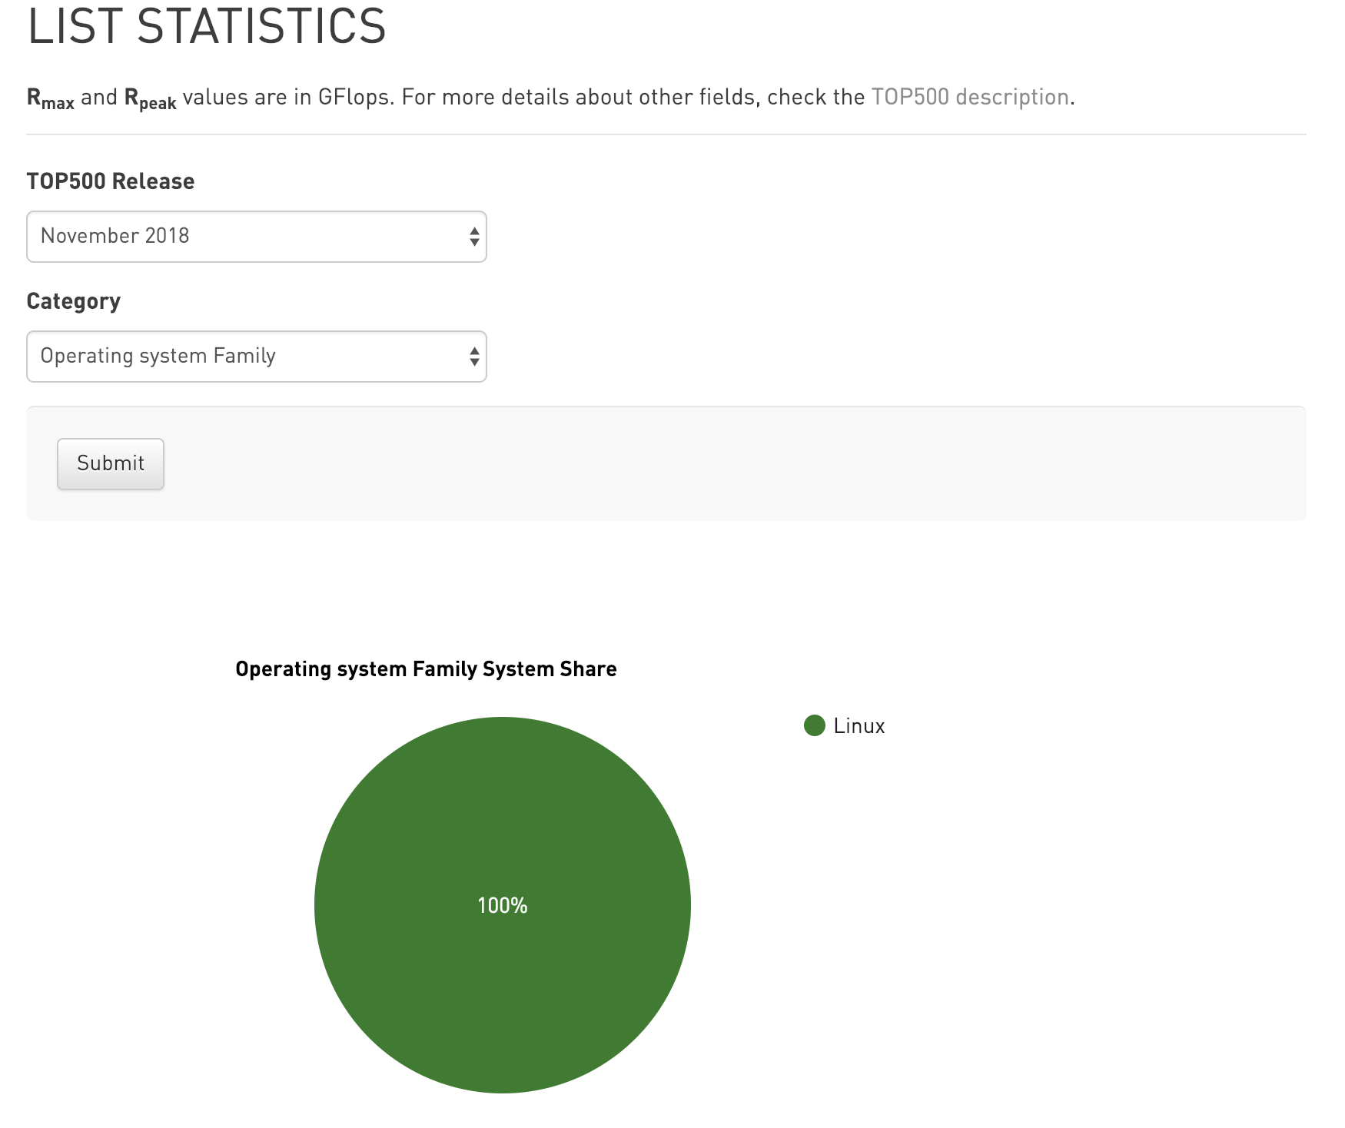
Scientific Computing for Biologists

Slide 20
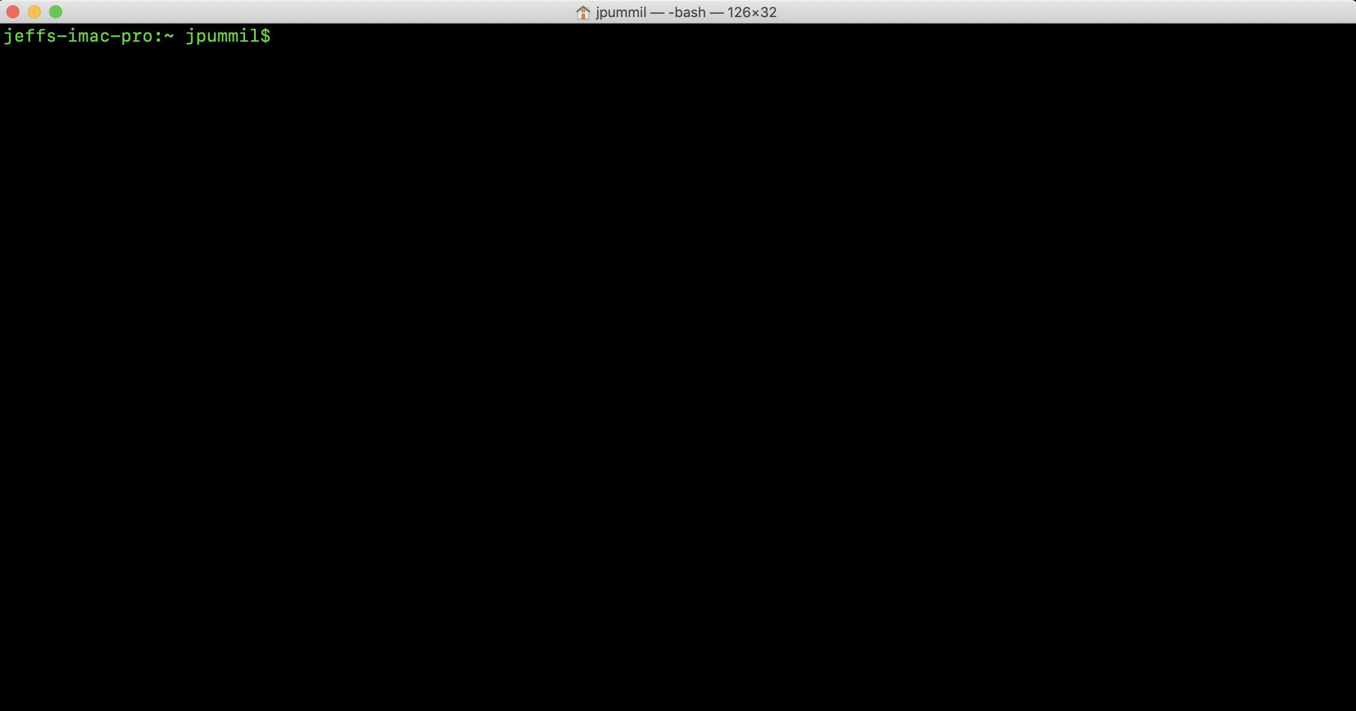
Scientific Computing for Biologists

Slide 21
Scientific Computing for Biologists
Why learn the command line?
It’s the foundation for most of bioinformatics
Enables use of non-GUI (Graphical User Interface) tools
Can quickly perform operations on large files
Reproducibility
Automation of repetitive tasks
Enables use of higher-powered computers elsewhere (server/cloud)

Slide 22
Scientific Computing for Biologists
Applying for an XSEDE Portal Account:
https://portal.xsede.org/#/guest
We’ll go thru this step by step in class. Please do not work ahead if you’re not certain of what to put in a given area!
Once complete, please send me your designated XSEDE Portal ID…I will need this to add you to the Jetstream Educational Allocation we’ll be using later on in this class.

Slide 23
Scientific Computing Resources
for Biologists
XSEDE Research Allocations
https://portal.xsede.org/allocations/research
We strongly encourage users to request a Startup Allocation prior to requesting a Research Allocation, in order to obtain benchmark results before you prepare your Research request. While having a Startup project is not absolutely required, the lack of benchmark results on the resources requested will greatly increase the level of scrutiny from the panel, especially for requests on highly oversubscribed resources.
SUBMISSION PERIOD | ALLOCATION BEGIN DATE
Dec 15 thru Jan 15 | April 1
Mar 15 thru Apr 15 | Jul 1
Jun 15 thru Jul 15 | Oct 1
Sep 15 thru Oct 15 | Jan 1

Slide 24
Scientific Computing for Biologists
Jeff Pummill
Director – Strategic Initiatives & User Services
Arkansas High Performance Computing Center
Adjunct Graduate Faculty – Biological Sciences
University of Arkansas – JBHT 410
jpummil@uark.edu
@jpummil on Twitter

